Slide 1


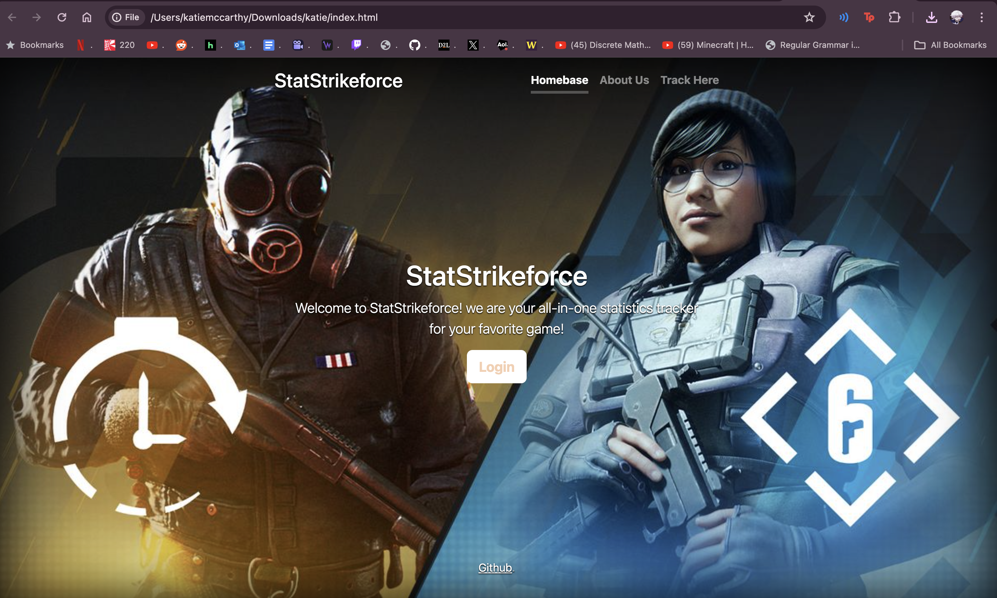
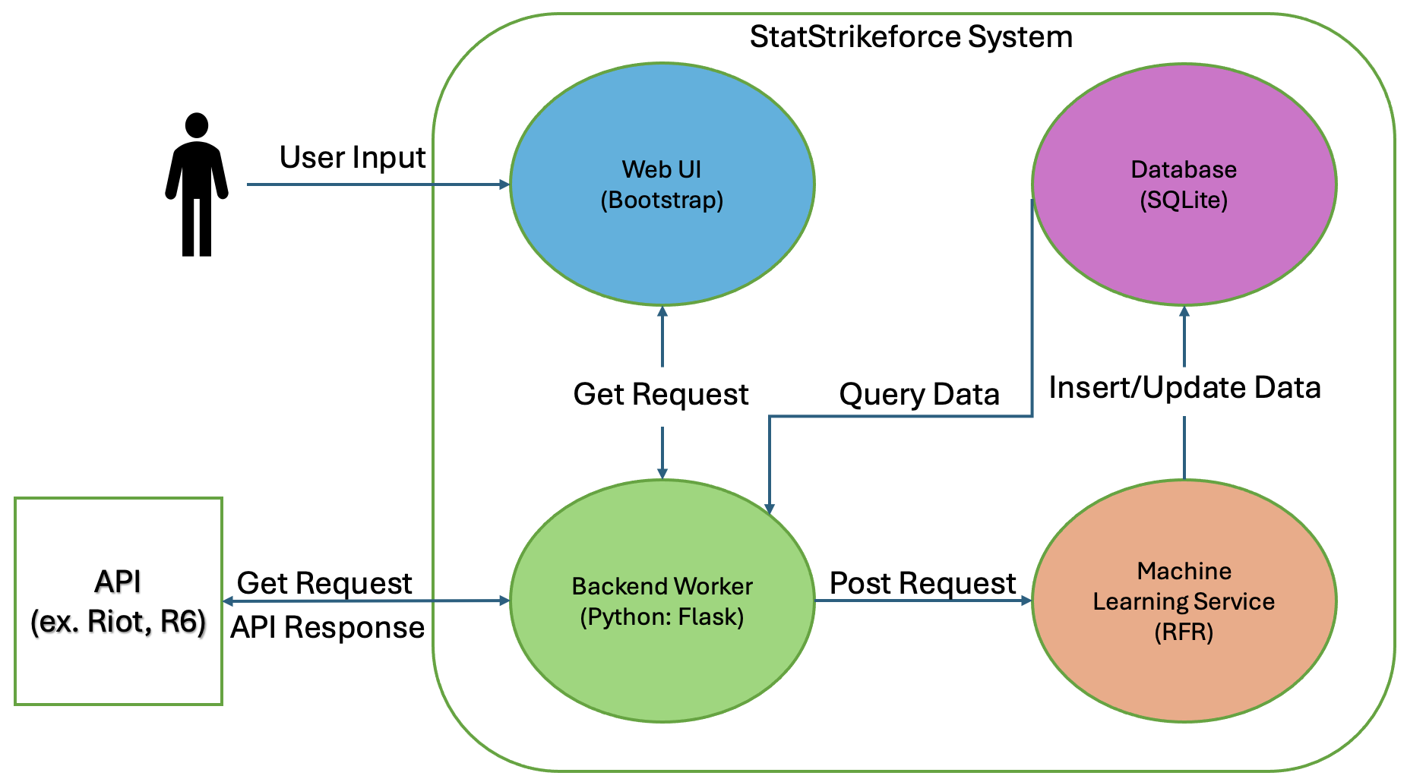
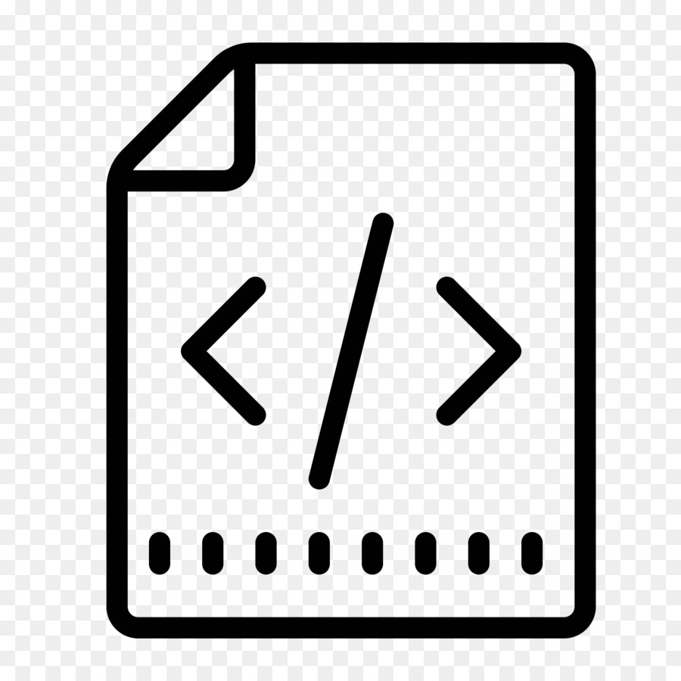



STATSTRIKEFORCE
Katherine McCarthy, Maxwell Mendenhall Ryan Sayre, Tobyn Sitar
PROJECT OVERVIEW
StatStrikeforce is a cloud-base web application, designed to reinvent the way you track your favorite video game statistics. The application allows for users to track their headshot percentage, Kill/Death ratio, win rate, and many other useful statistics with ease. StatStrikeforce gives players a competitive edge through its prediction feature, which uses machine learning to predict a player's performance and probability of a win in future matches based on recent match performance.
Web UI
For the Web UI, we plan on creating a homepage for users to login with their account information for their R6 account, leading them to a personalized page with all their statistics. The website features three sections, a Homepage, About Us page, and a Track Here page. We used Bootstrap and its libraries to form our vision for the user interface. The website features a sleek, aesthetic design to house all its capabilities.
Concept Architecture
The backend worker will communicate with the front end via GET requests.
Then backend will communicate with the Rainbow Six API to get user info.
POST requests will be sent to the Machine Learning service.
ML service will then query the data into the database, with the primary key being UserID.
Each UserID will have corresponding prediction values made with the user data from the API.
UserID |  | Predictions
(P) UserID: varchar platform: varchar Playerlevel: int Totaltime(hrs): int Wins: int Losses: int Win%: float Matches: int | Kills: int Deaths: int Assists: int K/D: float Headshot%: float Rank: varchar RP: int Tophero: varchar | P(Win): float P(K/D): float P(ΔRP): int Timestamp: int
Database Design
For our database design, we opted for SQLite, due to its space-saving abilities and compatibility with our backend through its own Python libraries to store and reference data.
UserID is used to store the game statistics, login credentials and basic profile information. Each user choosing a 'UserID' to be used as the primary key.
Predictions table stores predictions generated by the machine learning service. New predictions will be generated when data is deemed stale through Timestamp.
Cloud Deployment
Our CI/CD pipeline begins with source code written and tested locally, before pushing to our project's GitHub repository.
GitHub will then trigger the build process to have Docker push updated images.
Kubernetes will pull said images from DockerHub and run them in pods within our experiment nodes. GitHub will also push a deployment update to Kubernetes directly.
Once the application is deployed, we can test functionality and plan for future builds.

